Slide 1

AgriTech IoT
By Team Insight
In Collaboration with Centre for Technology Infusion

Slide 2


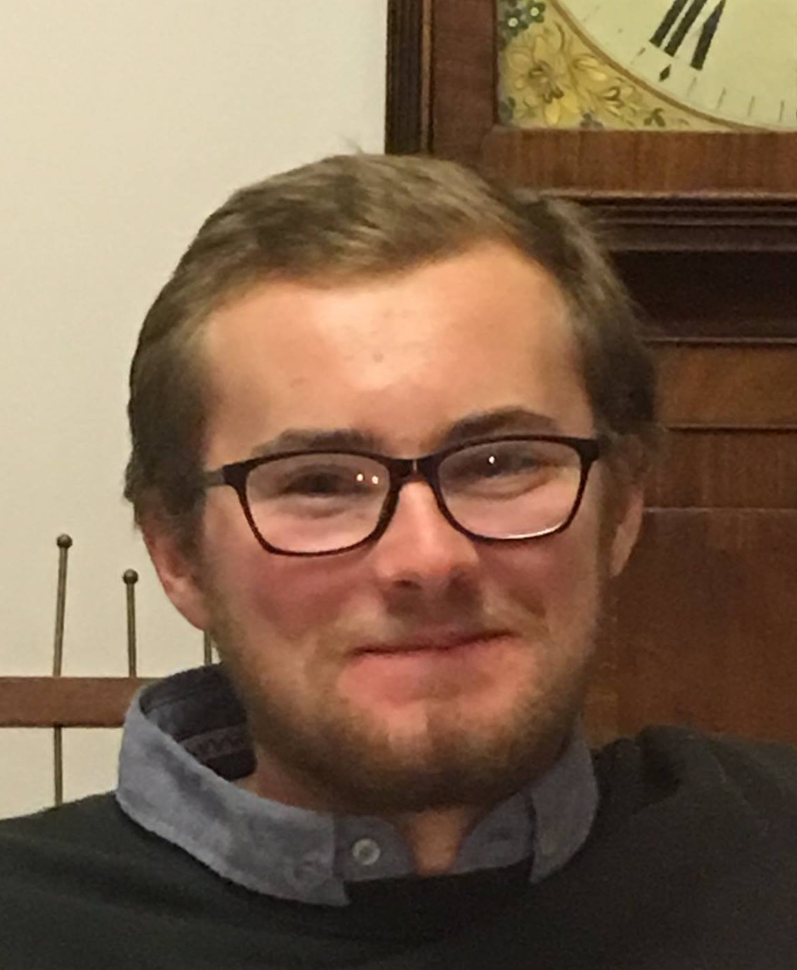
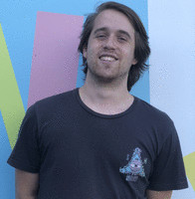

About our Team
M Alicia Hadisaputra – LoRaWan Gateway & Cloud administrator
Mona Abedi – Machine Learning & Database administrator
Liam Maguire – Frontend developer/designer
David Wisniewski – Hardware developer
Milind Rajpoot– Hardware developer

Slide 3
AGENDA
Project Overview & Sprint Implementation
EPIC & User Stories
Project Solution (demo)
Project Summary (Requirement & Constraints)
Testing & Upcoming Sprints
Usability
Burndown chart (Improvements)
Sensor
Raspberry Pi
UI Dashboard
Q & A
System Overview
Tools

Slide 4
The Problem
30 million sheep in Australia alone
Farmers have no efficient way of monitoring the health of livestock
Solutions provided so far are expensive

Slide 5
PROJECT REQUIREMENTS
Real time retrieval of data from sensors attached to animals
Retrieve data via LoRaWAN
Train data with machine learning algorithms
Store data within a database
Display data in an easy to understand manner

Slide 6
Constraints
Lack of face to face interactions
Inability to implement LoRaWAN as required
Inability to implement real time data

Slide 7
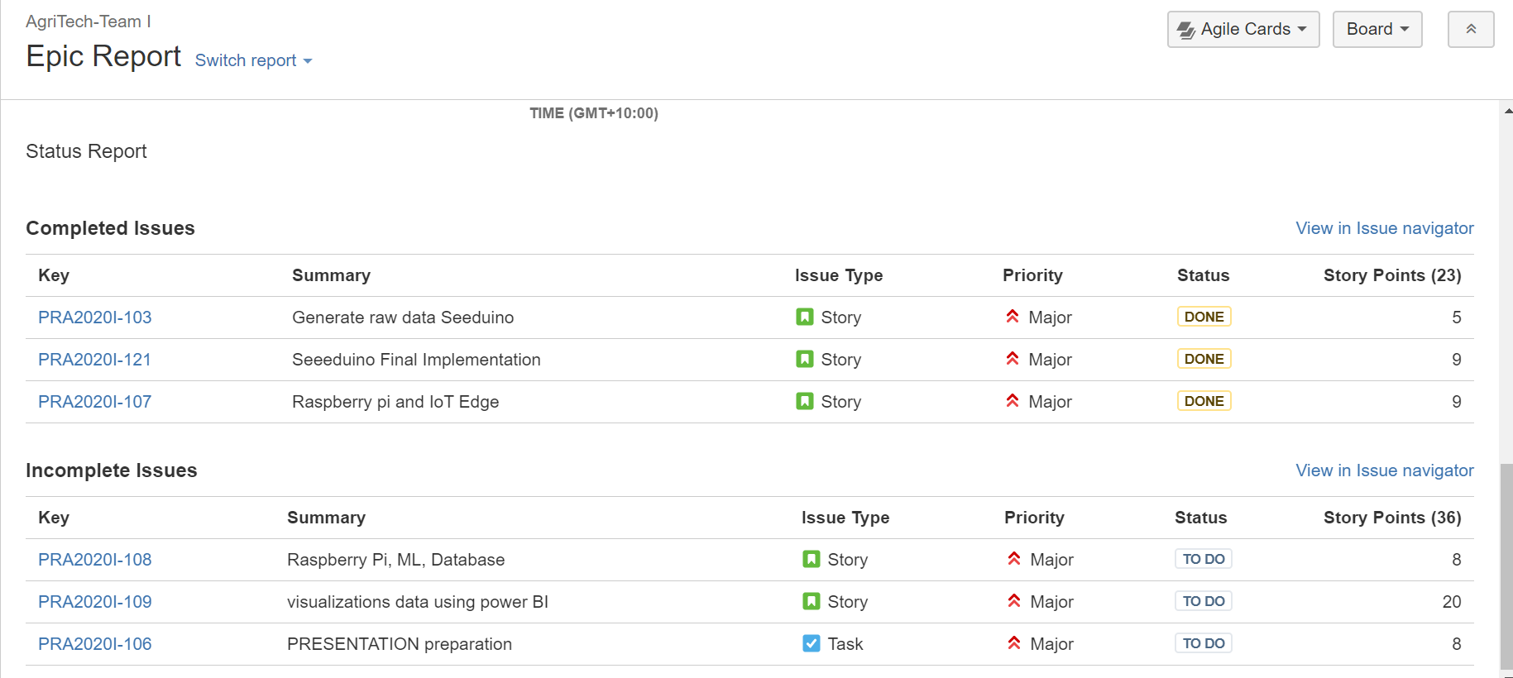
EPIC : Animal Activities Recognition

Slide 8
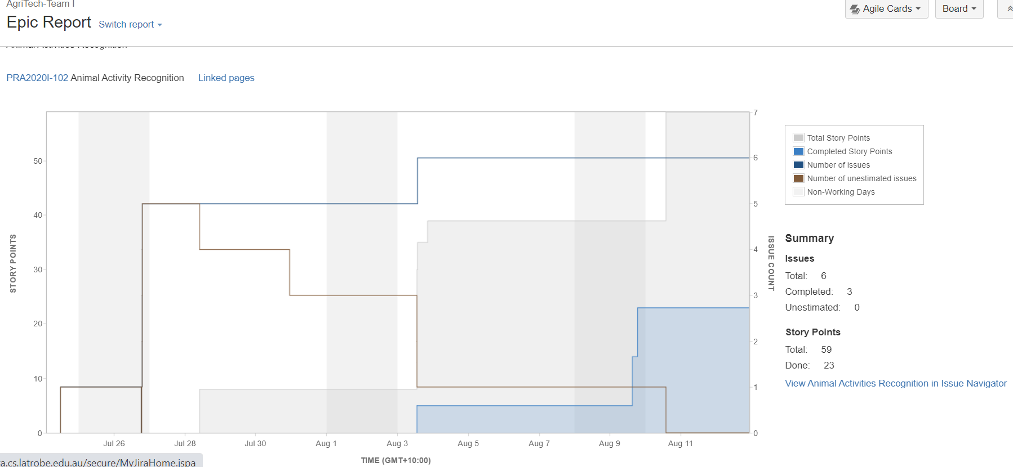

Slide 9
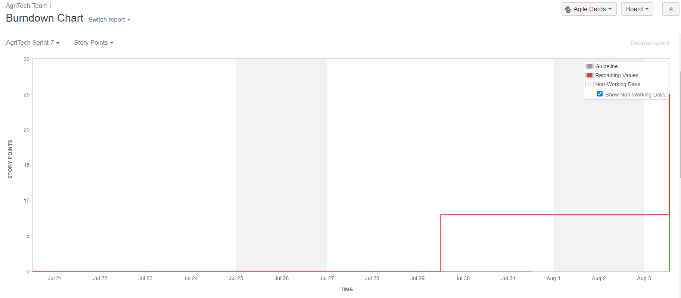
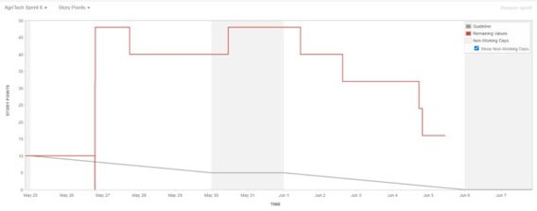
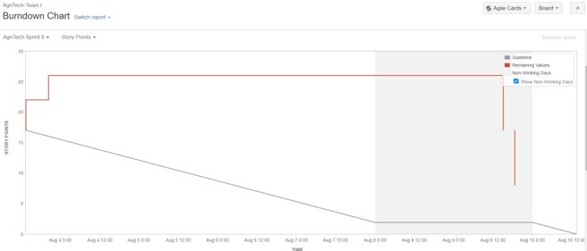
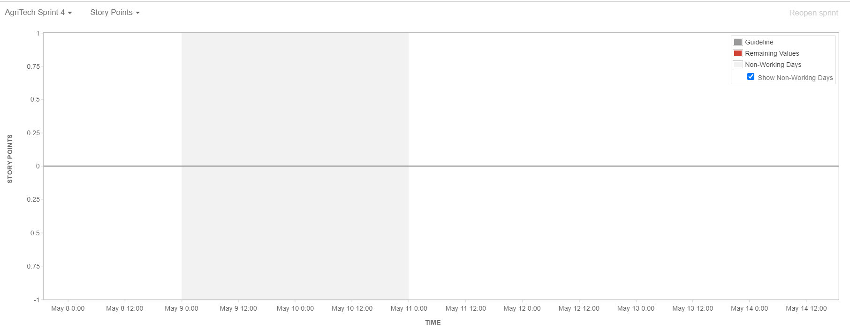
Improvements
Last Semester
Latest Sprints

Slide 10
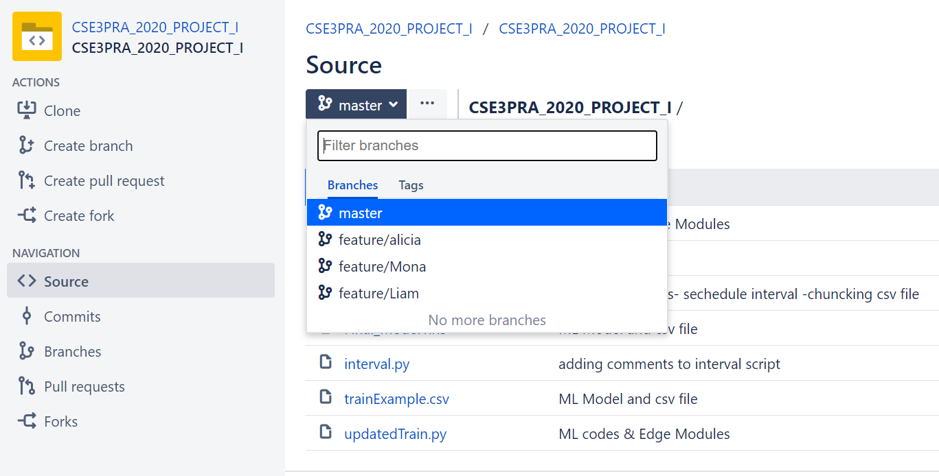
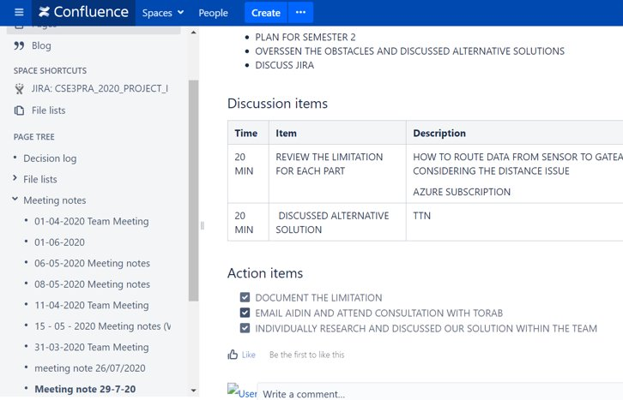
Project Management tools:
Bitbucket
Confluence

Slide 11
SYSTEM ARCHITECTURE

Slide 12
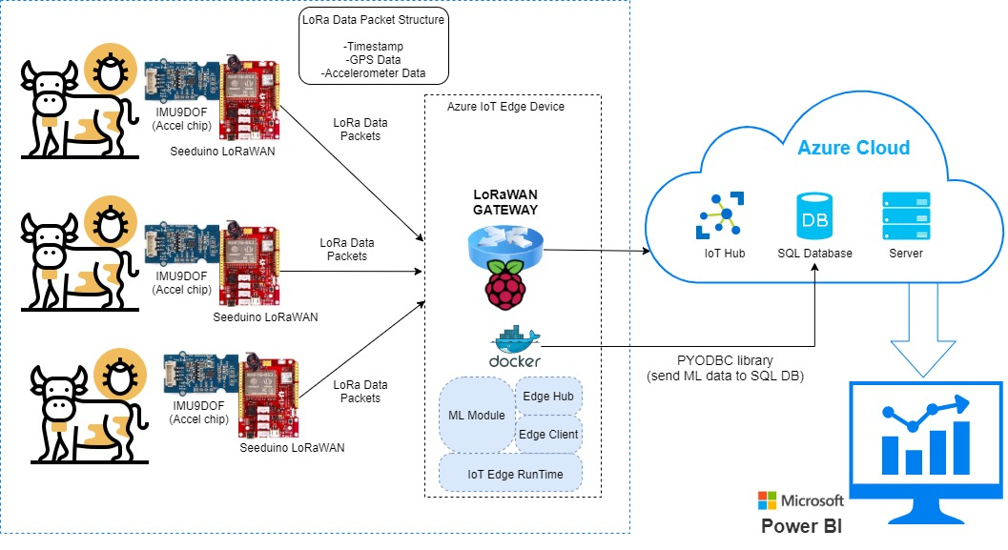

UI for primary stakeholder
Includes data like :
-Location
-Activity Status
-Health status

Slide 13
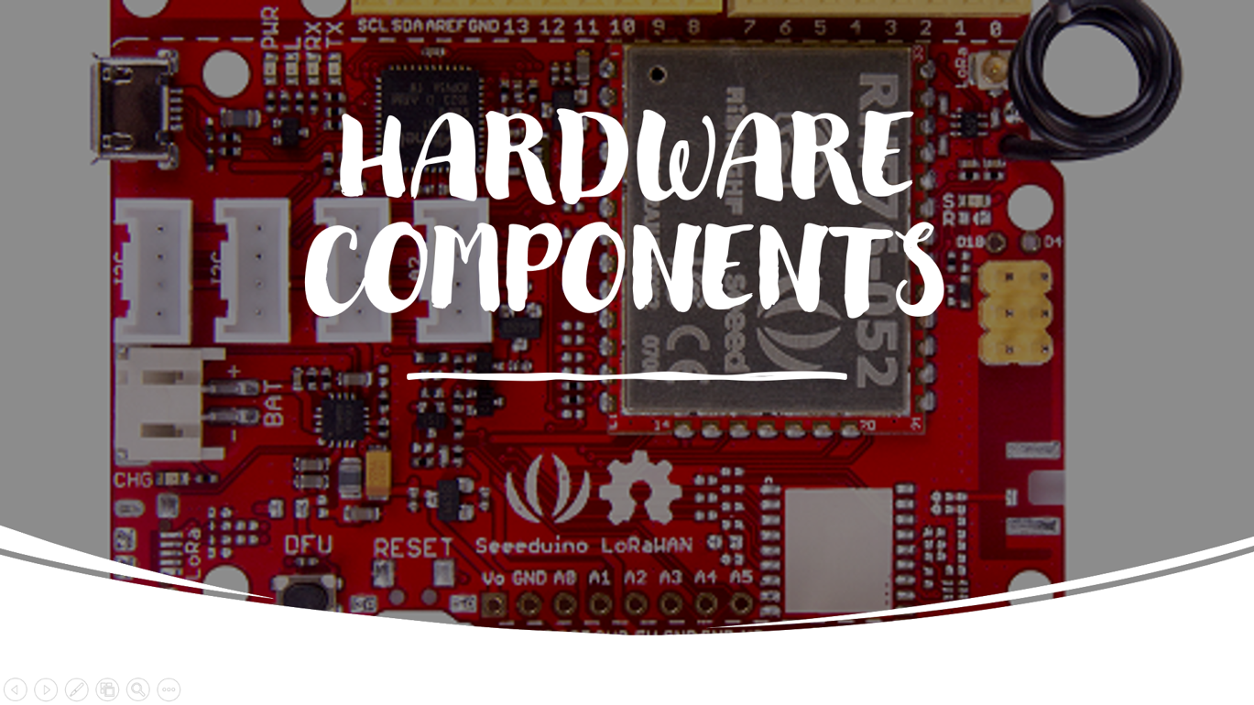

Slide 14
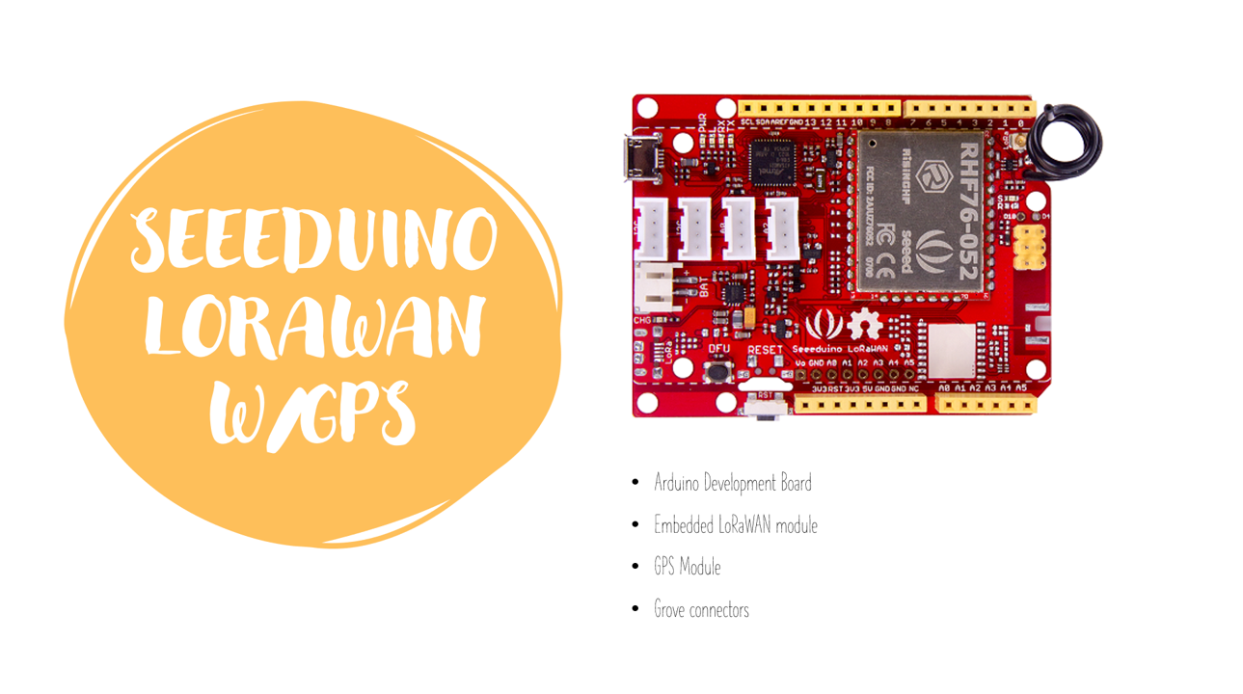

Slide 15
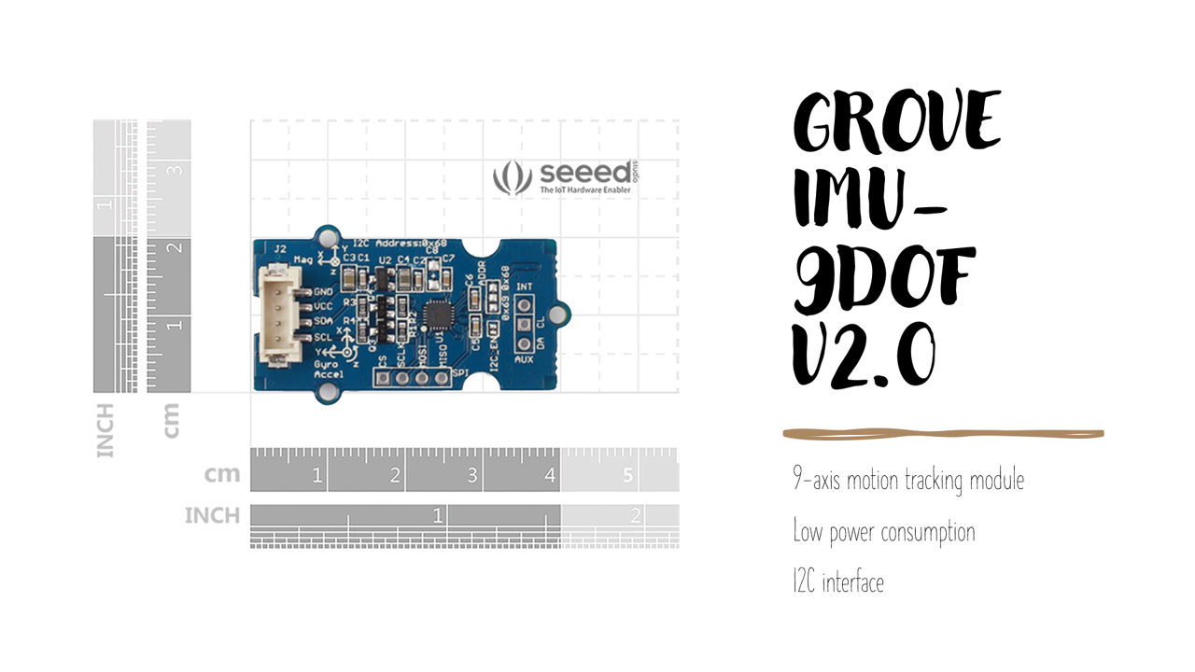

Slide 16
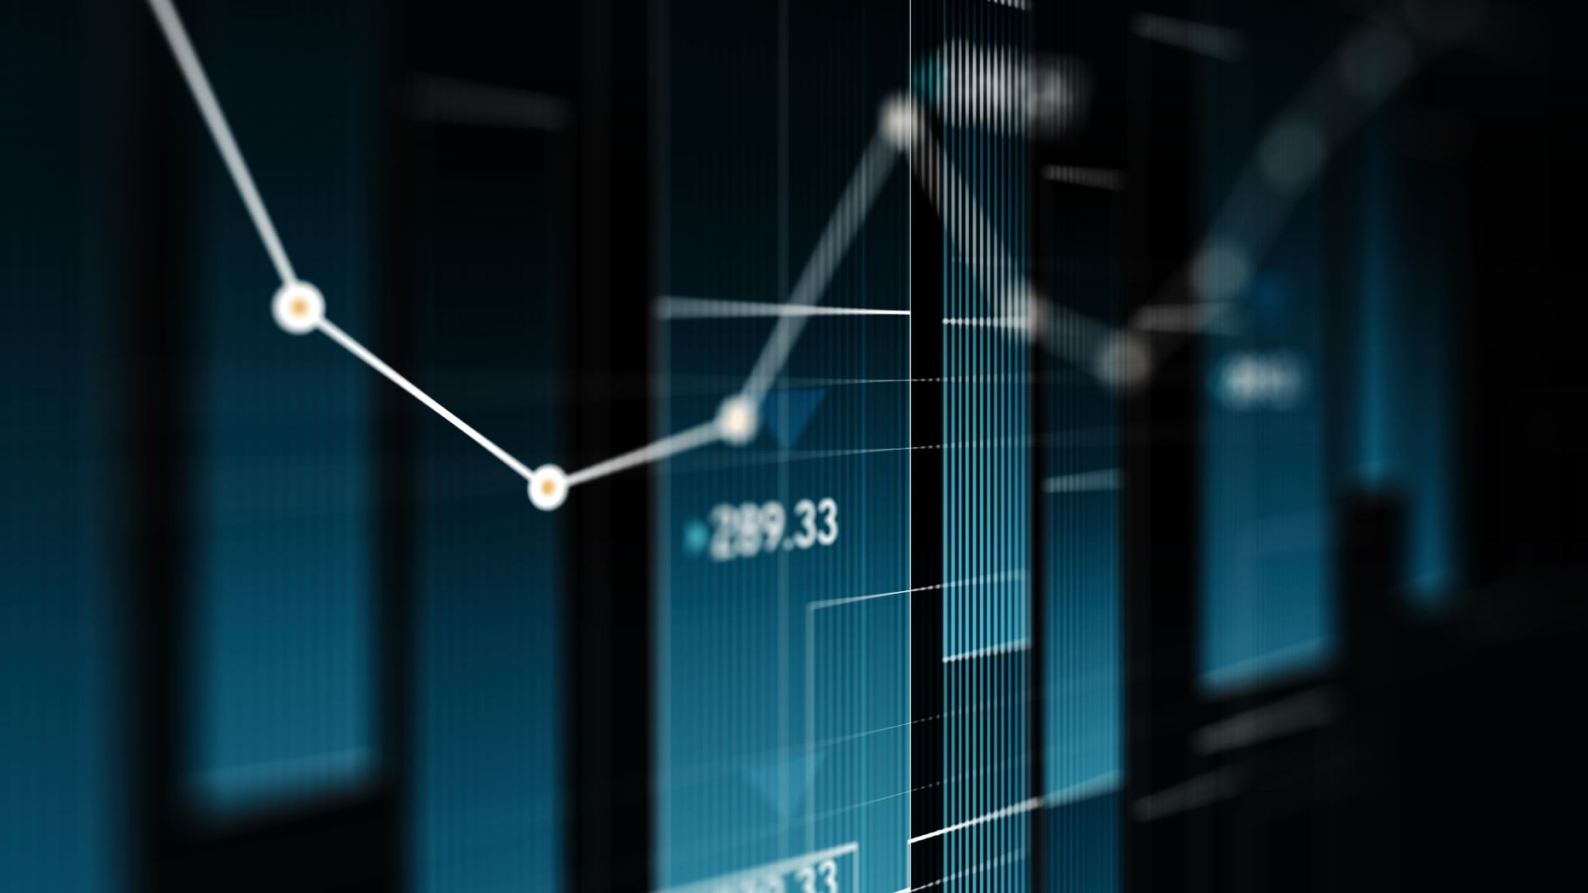
LAST PRESENTATION

Slide 17
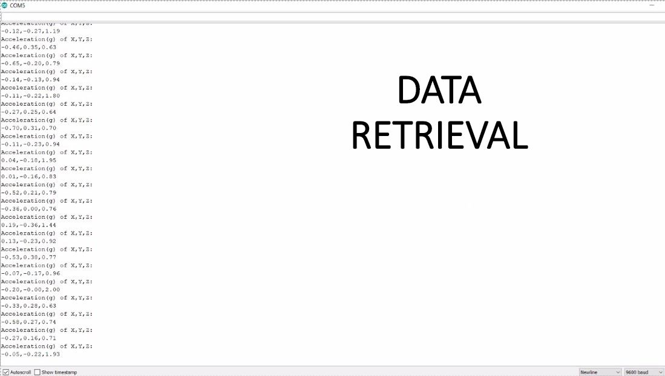
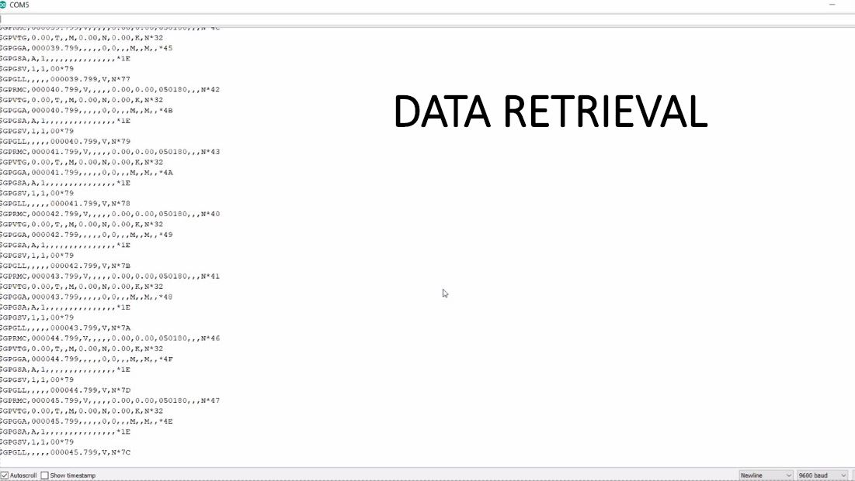

Slide 18

DATA PACKET

Slide 19
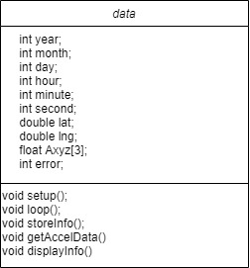
DATA PACKET UML

Slide 20
TODO : Attach new screenshot of serial monitor showing 30 samples per second

Slide 21
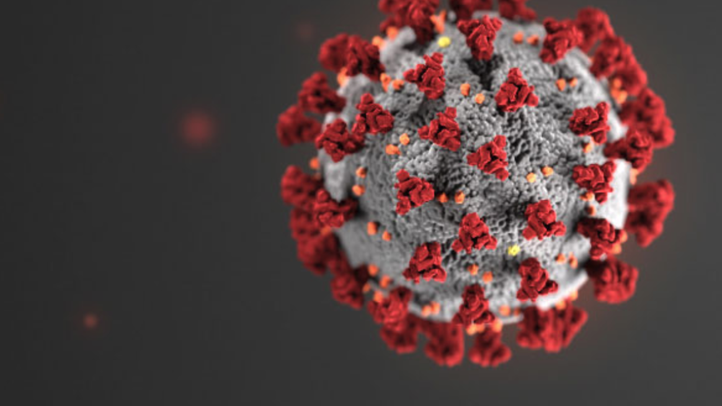
COVID CONSTRAINT

Slide 22

SENSOR DEMO

Slide 23
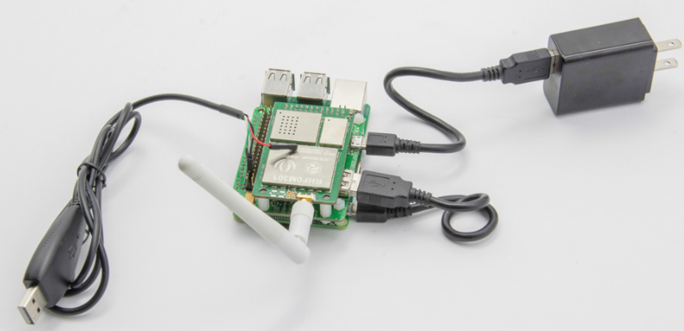
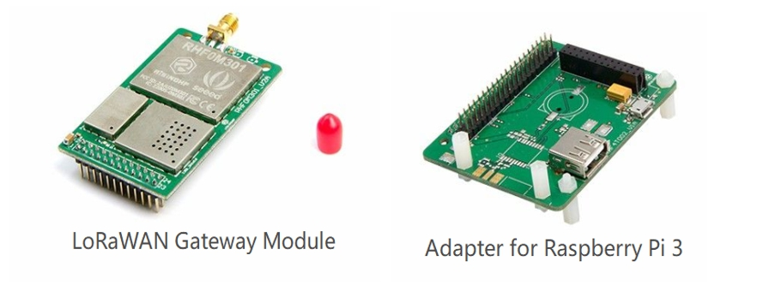
LoRaWan Gateway

Slide 24

Main Technologies
Azure IoT HUB
Azure IoT Edge
Docker
Notes:
In our gateway, we are running azure IoT edge which is accessible from Azure IoT HUB.
It's mainly to manage the gateway - manages communication with the network server,
monitor packets coming in, and also running most of the processing locally
which then to send only the end result to the cloud.
As a part of IoT edge functionality, we are also using docker containers in our implementation.

Slide 25
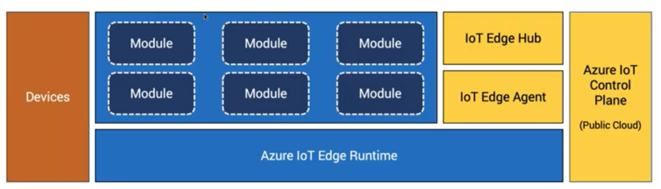
IoT Edge Architecture
Modules we are running on the gateway:
LoRaWanNetworkServer
LoRaWanPacketForwarder
Machine Learning Model
Notes:
IoT Edge modules are containers that run Azure services,
third-party services, or your own code. Modules are deployed to IoT Edge devices
and execute locally on those devices
IoT Edge modules are implemented as Docker-compatible containers on your IoT Edge device.

Slide 26
Benefit of Docker Containers
Reproducibility
Isolation
Security
Environment Management
Continuous Integration
Notes:
REPRODUCIBILITY -
a Docker container is guaranteed to be identical on any system that can run Docker. In our case, as we will have many devices on the field, this is an amazing technology for deployments. And with docker we won't have to set up the environment manually on each of the devices.
It also enforces ISOLATION
Because Dependencies or settings within a container will not affect any installations or configurations on other systems or on any other containers that may be running. This makes it more efficient in terms of solving any technical issues within a container or a devices that may arise.
With that being said, this also will benefit the SECURITY of the system, because if one container is compromised the others remain unaffected.
For Environment Management: Docker makes it easy to maintain different versions of the container, we can have a separate container for testing, development, and production on the group of devices for testing and easily deploy to the rest of devices once it's production ready. for e.g new ML algorithms to test
All of these benefits are very significant when thinking of Continuous Integration of our project.

Slide 27
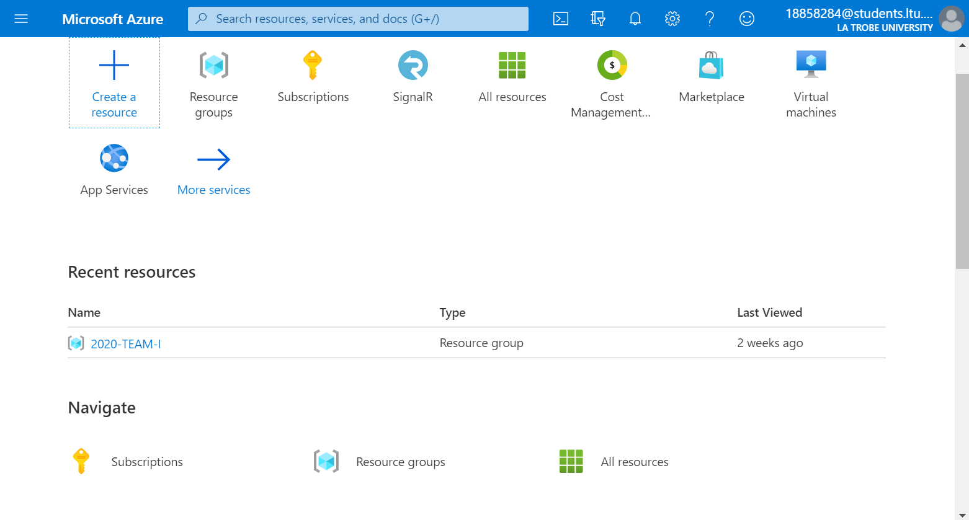

DEMO

Slide 28
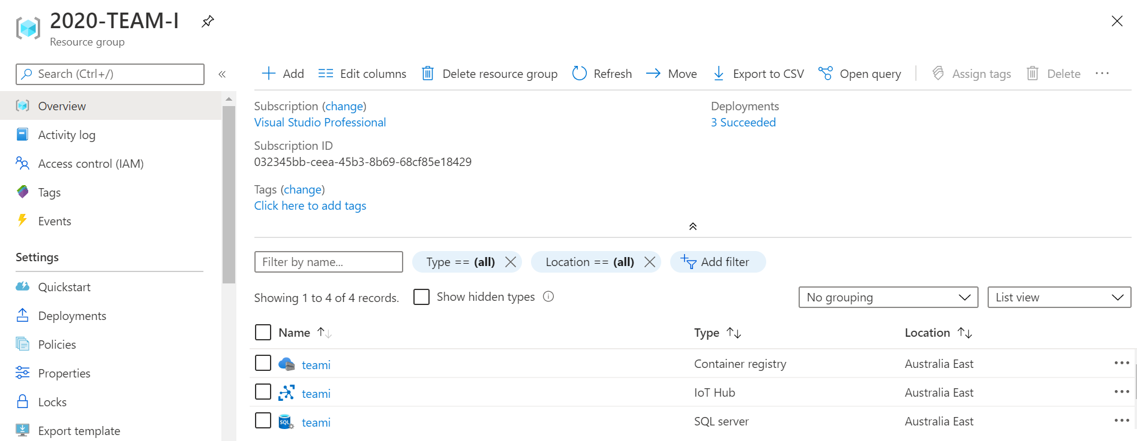


Slide 29
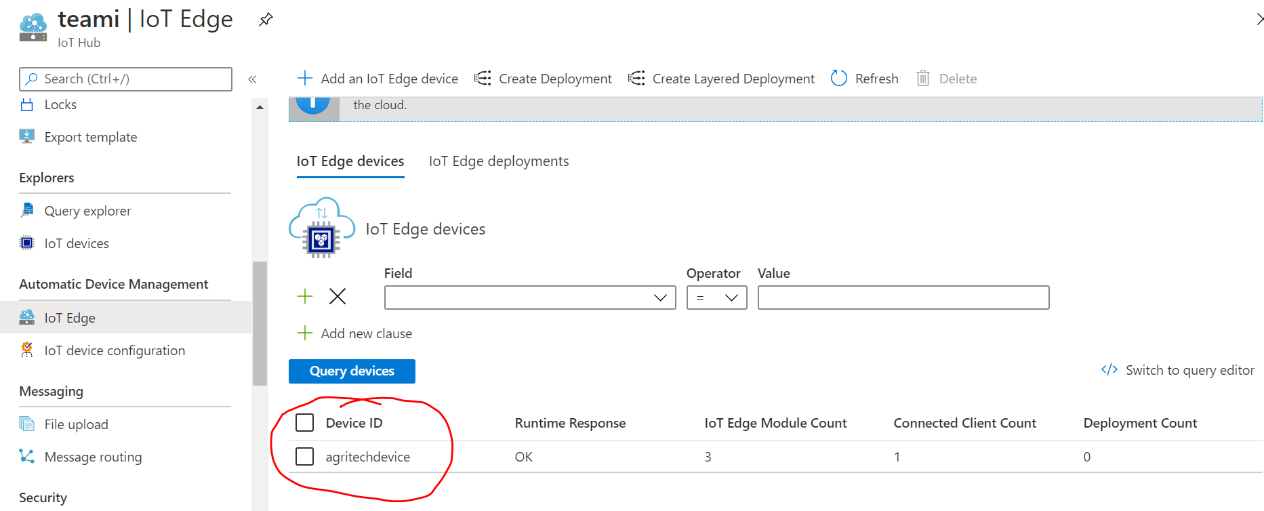

Slide 30
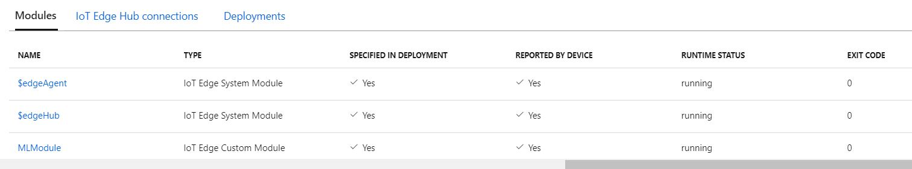
IoT Modules

Slide 31
The Purpose of Machine Learning
Walking , Rumination , Idle, Grazing, Licking

Slide 32
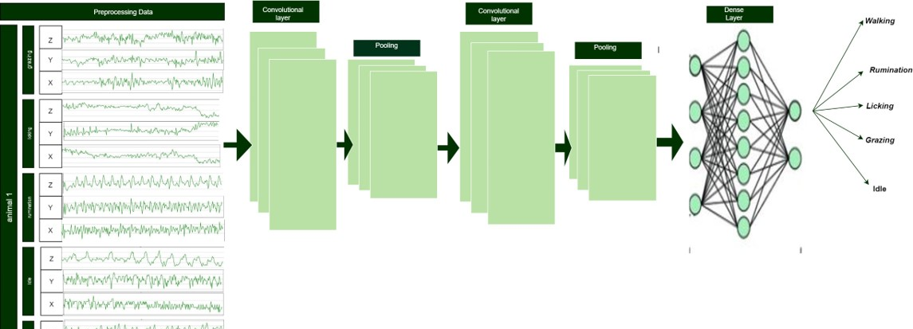
Build Machine Learning Model
CNNs
Python

Slide 33
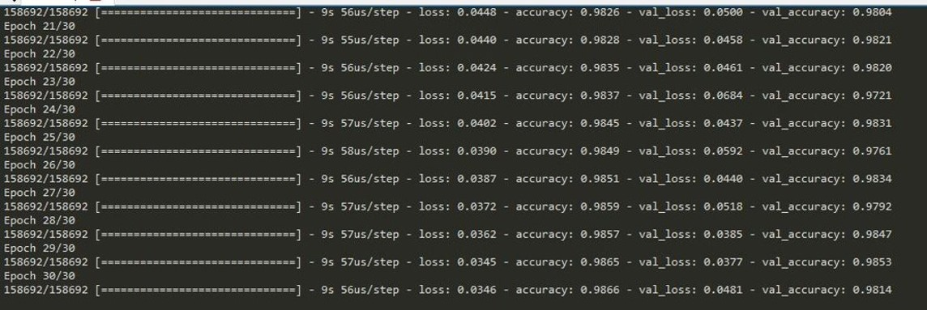

Slide 34
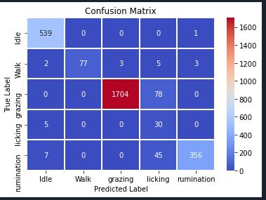
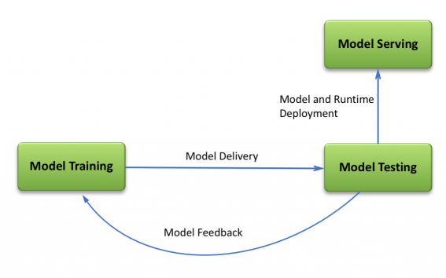
Testing Strategy
Typical Machine learning flow

Slide 35
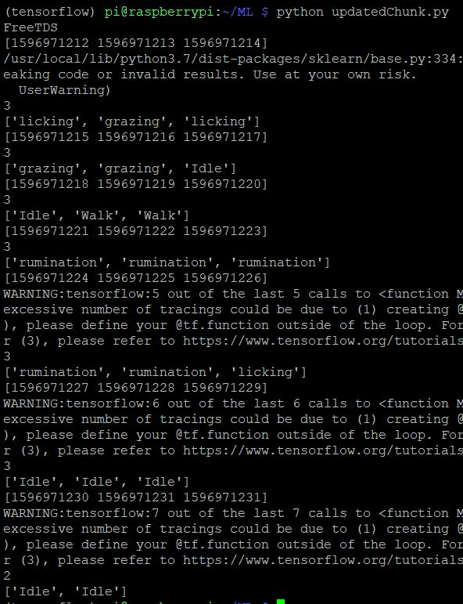
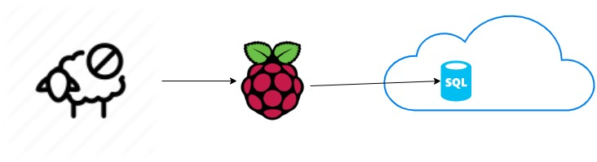
Deployment On PI

Slide 36
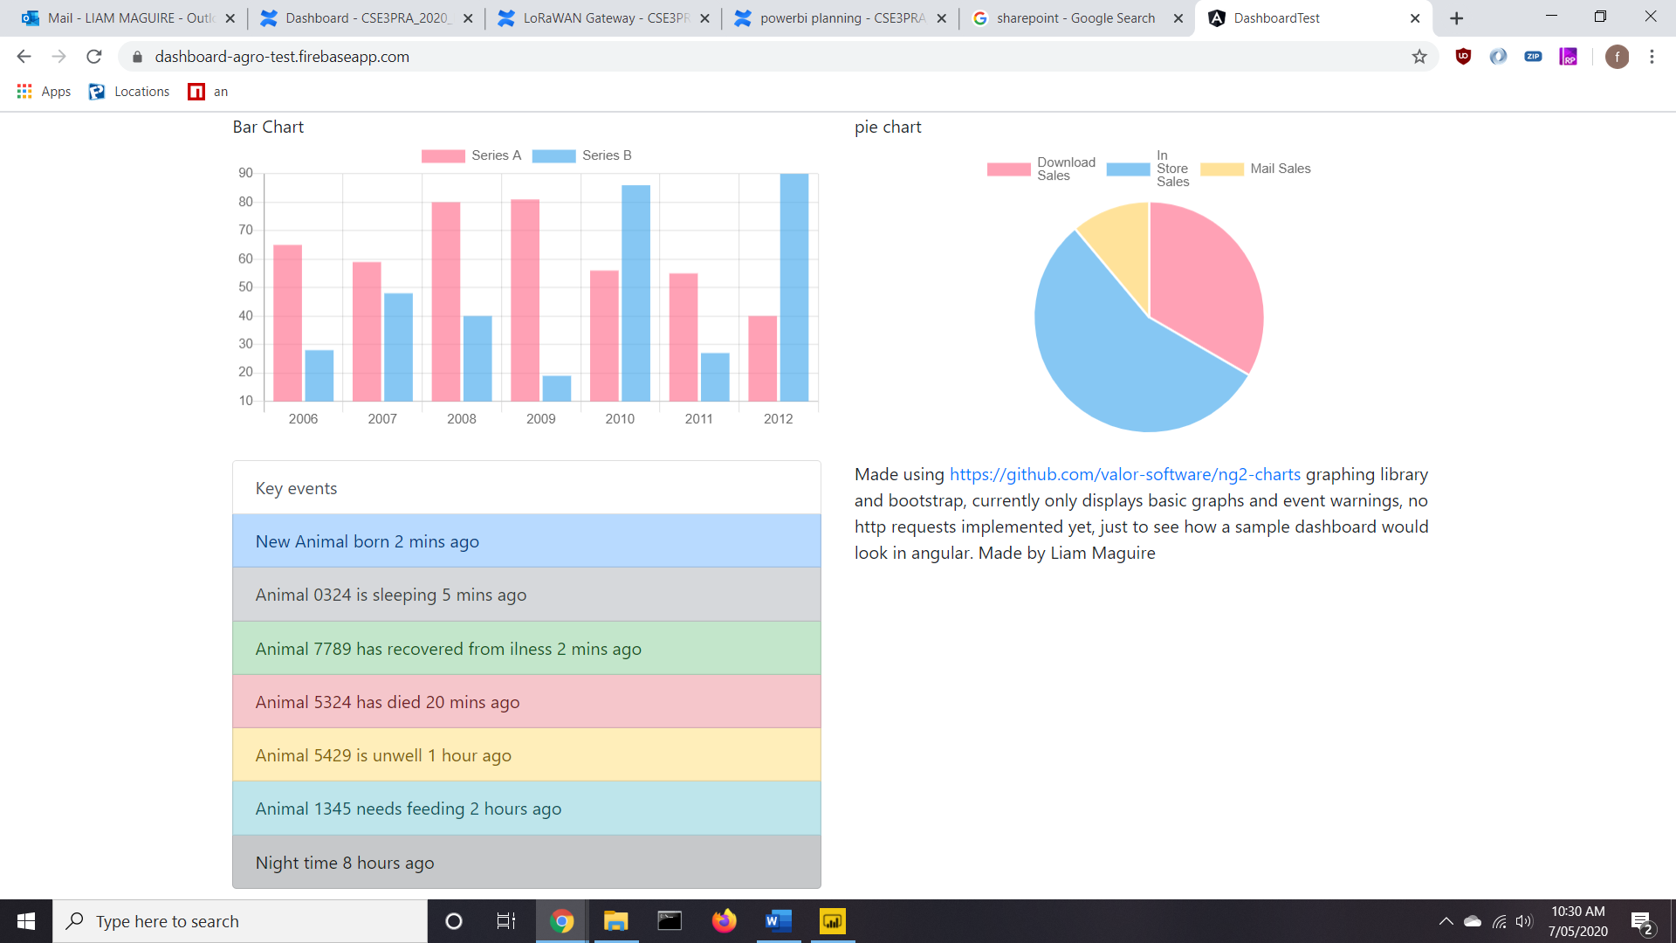


LoRaWan Gateway
Power BI
DashBoard

Slide 37
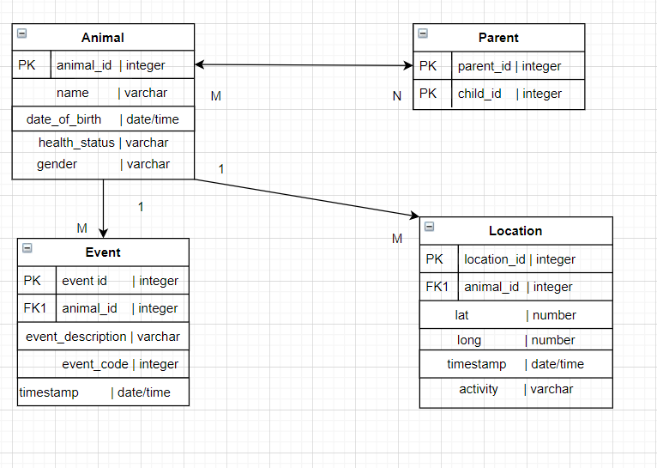

Slide 38

USABILITY AND TESTING
USER SURVEY
USABILITY TESTING
SYSTEM USABILITY SCALE
REVIEW

Slide 39
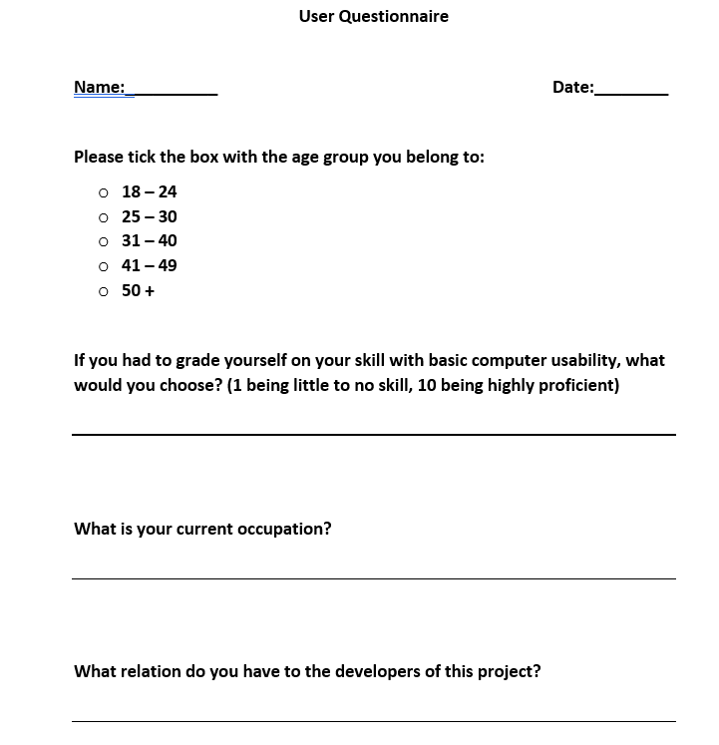
User Questionnaire - attempt at the full picture

Slide 40
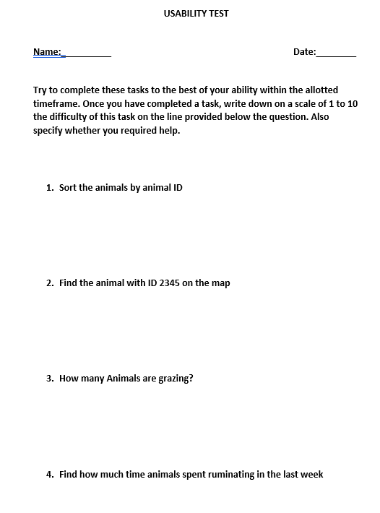
User test

Slide 41
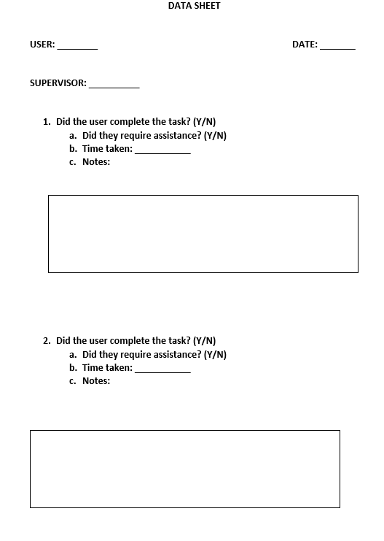
Supervisor report

Slide 42
System Usability Scale
10 questions
Scored from 1-5
Overall Usability Value

Slide 43
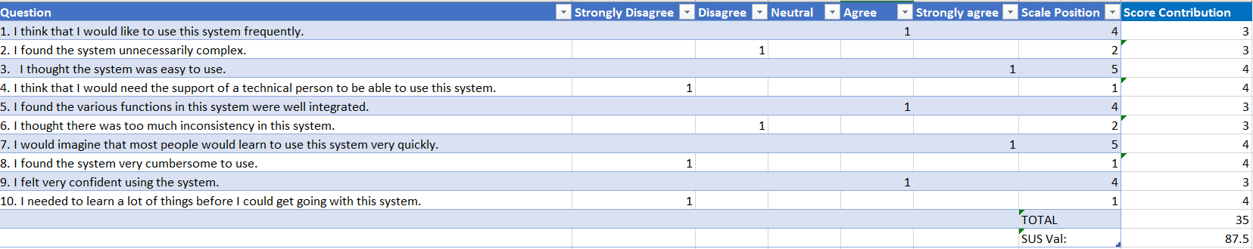
The test

Slide 44
Further
Usability report
Usability metrics

Slide 45


Q & A

